Slide 1


CHECK
PO
I
NT

Slide 2

Original intention
TO CREATE MARKET STORAGE APP THAT HAVE MORE ADVANCED DESIGN THEN OTHERS AND HELPS CASHIERS , ADMINSTRATORS,
MANAGERS WITH PRODUCT SEARCHING,SORTING AND TOTAL ORGANZATION
IN THE MOST PLEASANT WAY
.

Slide 3



TARGET
Versatile
User-friendly
Open source

Slide 4

Problems
we are solving
Inefficient Product Management
Complex User Interfaces
High Costs
Data Security Concerns
Time-Consuming Manual Processes

Slide 5
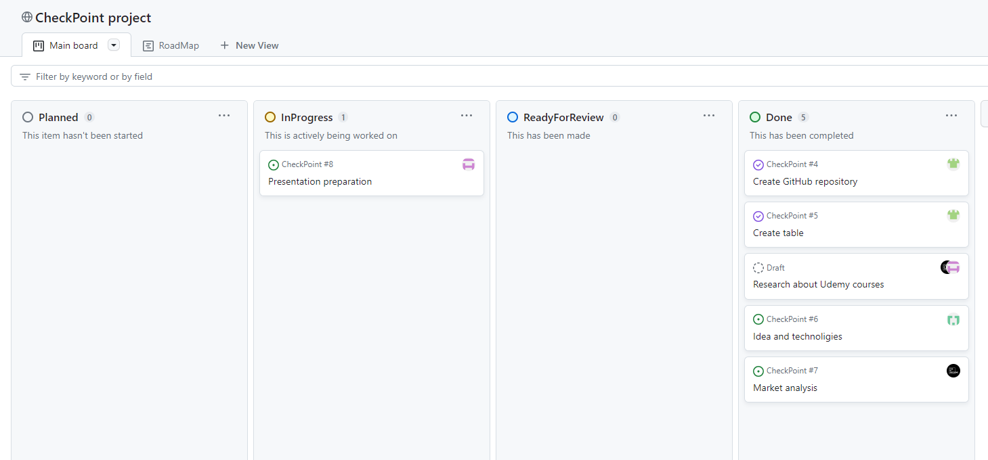
Our kanban board on
GitHub

Slide 6





Technology
stack

Slide 7
COMPETITORS CONS AND PROS
ADVANTAGES
DISADVANTAGES
Pricing:
Their pricing structure may be relatively high, making it less accessible for small businesses or startups
Established Market Presence:
They have been in the market for a while, which means they likely have a substantial customer base and brand recognition.
Feature Set:
They offer a comprehensive set of features, including product searching, sorting, and organization tools, catering to various user roles.
Limited Customization:
While their app offers a wide range of features, it may not be highly customizable to meet specific business needs.
Mobile Accessibility:
Their app has a robust mobile interface, allowing users to access it on various devices.
User Interface:
User interface can be somewhat cluttered and less intuitive than other solutions.

Slide 8
THANK
YOU
FOR
ATTENTION

Slide 9

I DON'T HATE MONDAYS
I DON'T HATE MONDAYS
MONDAYS THAT HATE ME
MONDAYS THAT HATE ME

